Slide 1

Visual Odometry
using April tags
Software for Robots -Sose2020
Group-4
Mangal Deep.B.M(7206937)
Bheeshmaraya B V(7206909)
Notes:
1

Slide 2
Introduction
Odometry:
Use of data from motion sensors to estimate change in position over time - Wikipedia
Wheel encoders measure the revolution of robot's wheels.
It provides information about the change of position.
it has its own initial state and coordinate frame.
Visual Odometry
Use of optical sensors to achieve the functionality of an odometer.
Typically, cameras are used to detect different features in the image frame and the relative
motion of the object or the Host are determined by sequence of images by
Monocamera - provides angle information only
Stereocamera - provides angular and depth information
Omnidirectional cameras

Slide 3
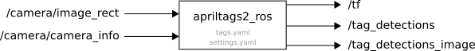
Visual Odometry using April Tags
April Tags:
It is a visual fiducial system used in the field of robotics, augmented reality.
Its applications include camera calibration, object tracking, visual localization, SLAM accuracy evaluation, and human robot interaction.
April Tag –ROS:
An April Tag ros library is available as a package which would enable us to get the tag information
It subscribes to topic /rover/raspicam/image_rect which is assumed to have undistorted image
Provides the relative pose information between the Apriltag and the raspicam_image frame in the topic /rover/tag_detections

Slide 4
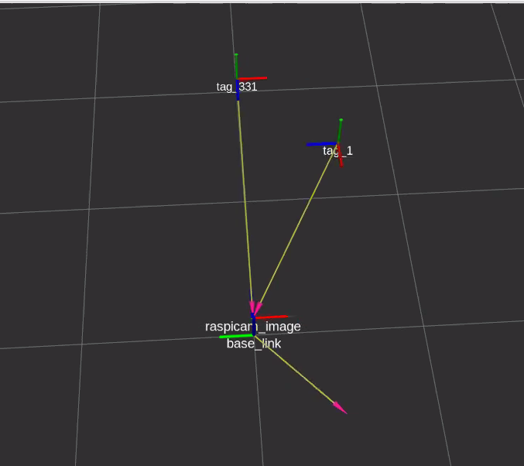
Visual Odometry using April Tags

Slide 5
Visual Odometry using April Tags- summary
We have created a node to perform visual odometry.
Subscribes to the /rover/tag_detections topic
Get pose information of the rover with respect to the tag.
Select the nearest tag to the rover.
Calculate the pose(odometry) information with respect to the tag.
Apply Lucas-Kanade algorithm, when no tags are detected.

Slide 6
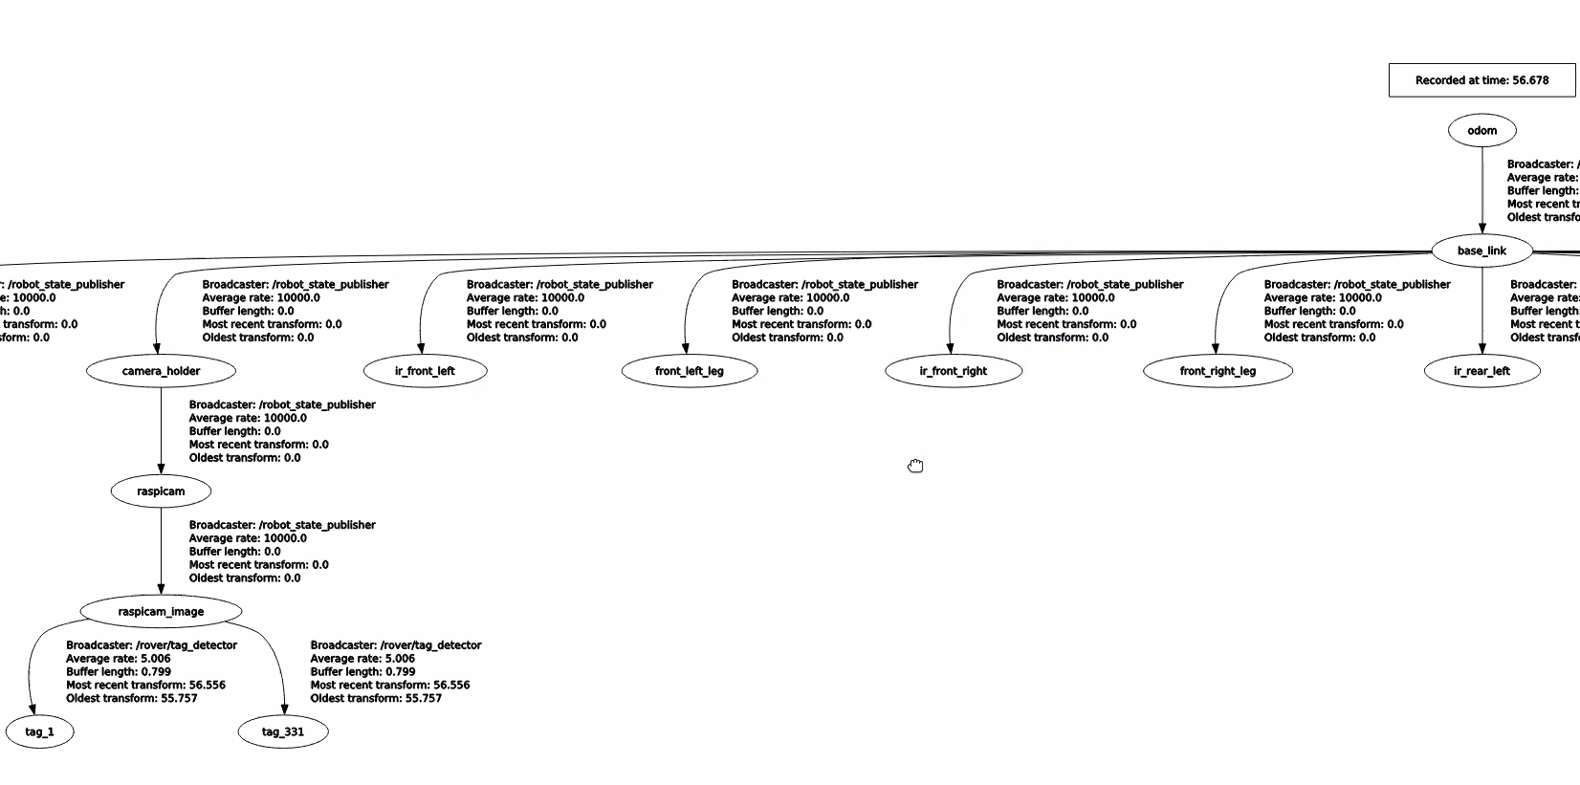
Visual Odometry using April Tags- II
As the pose information is available in the raspicam_image frame,It needs to be transformed to base_link, In order to get the pose information in rover coordinate frame.
BL_T_CI = BL_T_CH * CH_T_C * C_T_CI

Slide 7
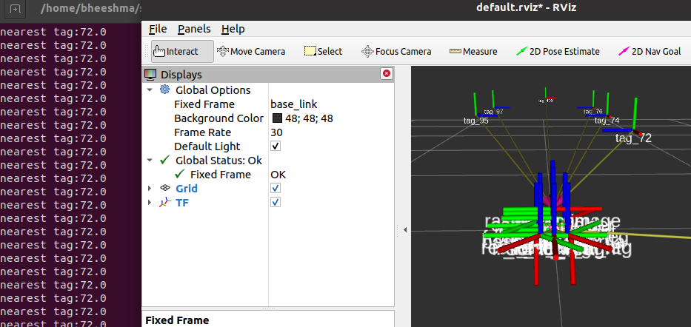
Visual Odometry using April Tags-III
For Estimating the pose, when multiple tags are detected, the nearest tag must be considered.
Euclidean distance is used to find the nearest tag.

Slide 8
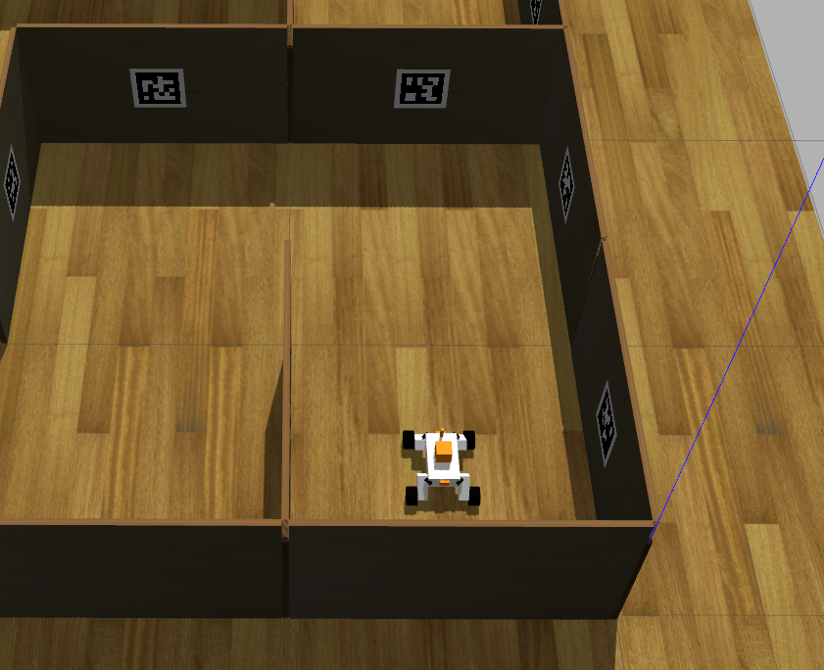
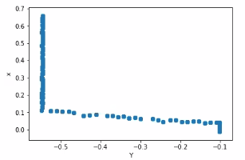
Visual Odometry using April Tags- IV
The difference of pose of at t and t+1 are consistently considered to get final pose wrt to initial pose of robot.

Slide 9
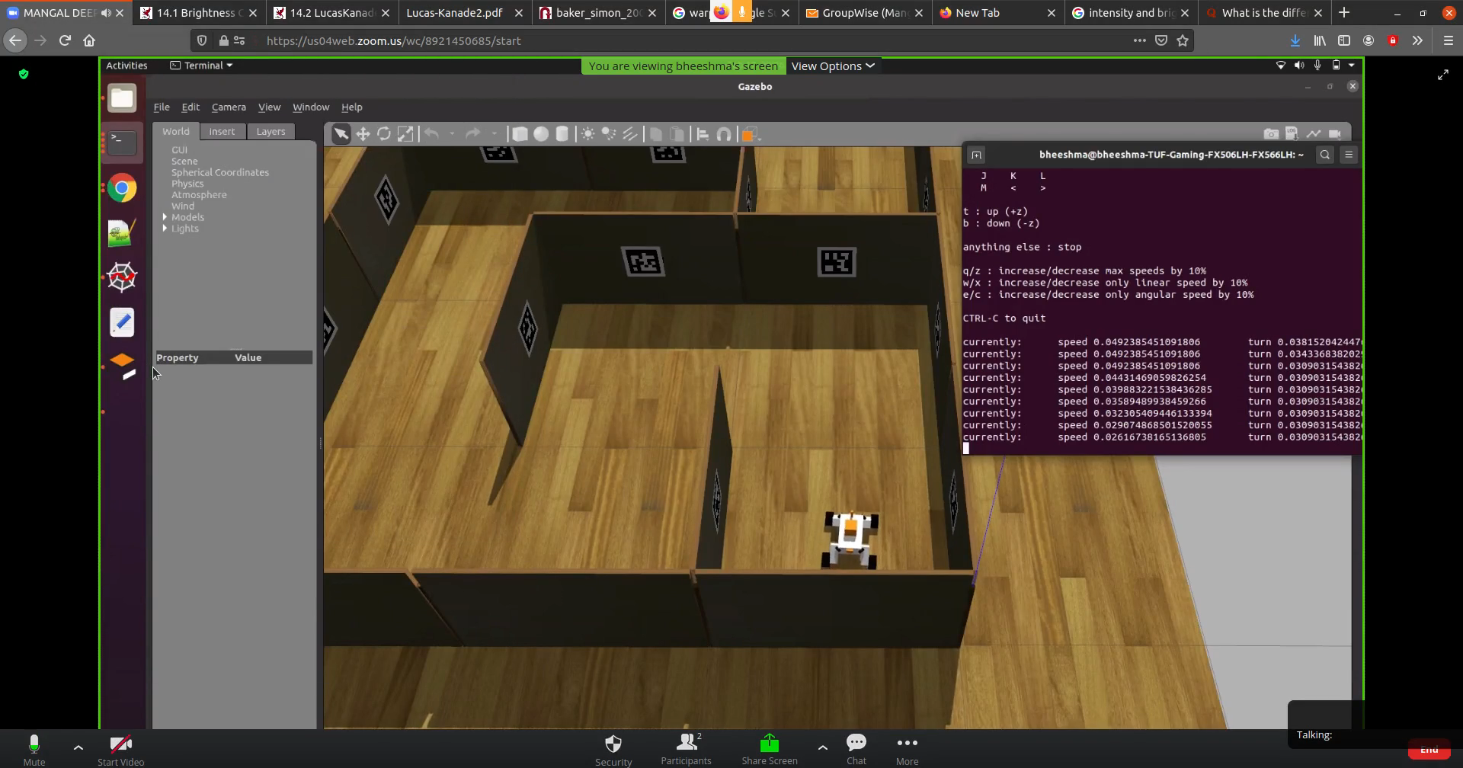
Visual Odometry using April Tags- IV

Slide 10
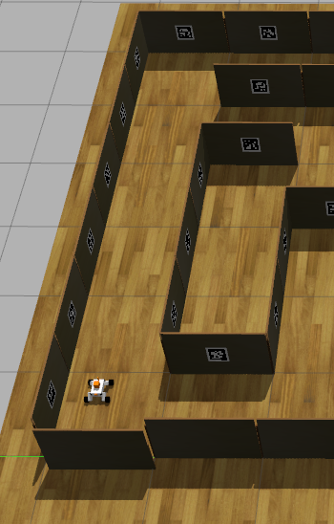
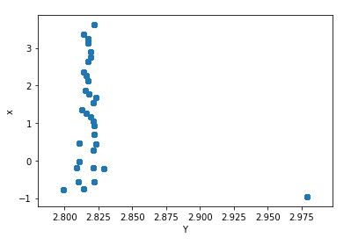
Visual Odometry using April Tags- IV

Slide 11
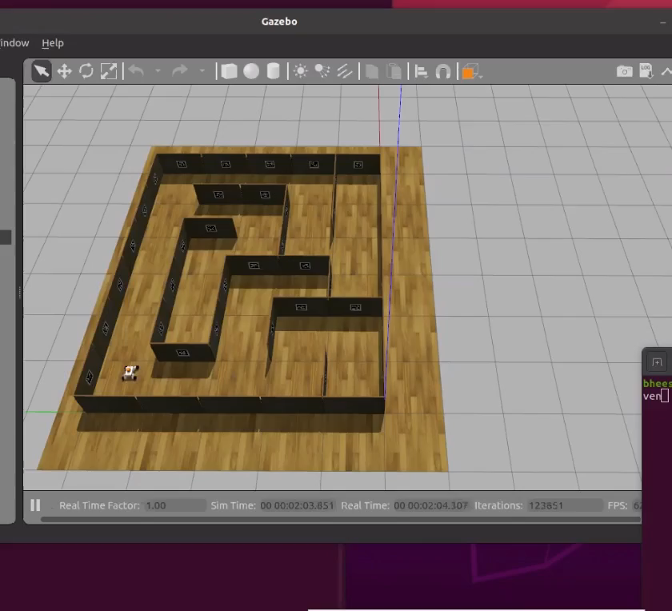
Visual Odometry using April Tags- IV

Slide 12
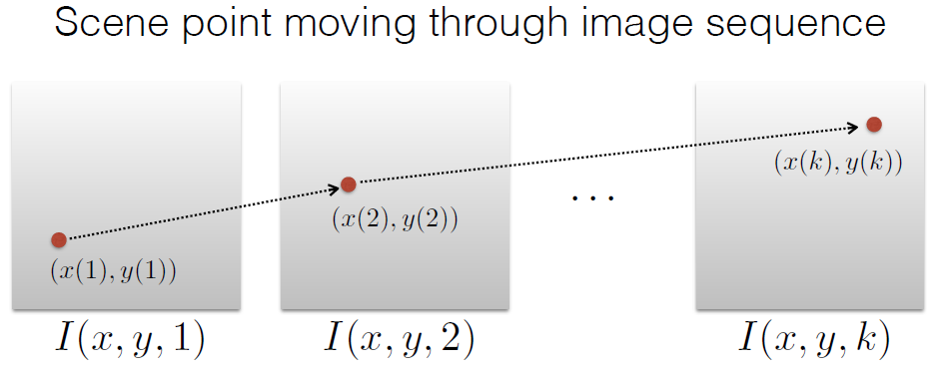
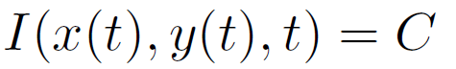
Lucas-Kanade – Optical flow algorithm
Lucas Kanade algorithm is a simple technique which can provide estimate of movement of specific features in successive image of a video feed.
We can derive the movement vectors of a particular pixel by comparing two consecutive
Images.
The assumptions made are:
1. Brightness constancy : The point of features to be tracked in an image has a constant brightness throughout all the frames in the scene
Source: http://www.cs.cmu.edu/~16385/s15/lectures/Lecture21.pdf

Slide 13
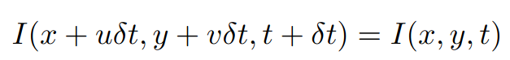
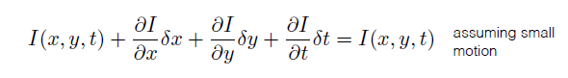
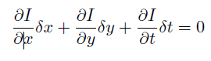
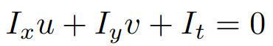
Lucas-Kanade – Optical flow algorithm
2. Motion is small
Difference in time between two consecutive images is very less.
For very small steps the brightness between two consecutive image frames is the same.
Flow is locally smooth
Source: http://www.cs.cmu.edu/~16385/s15/lectures/Lecture21.pdf

Slide 14
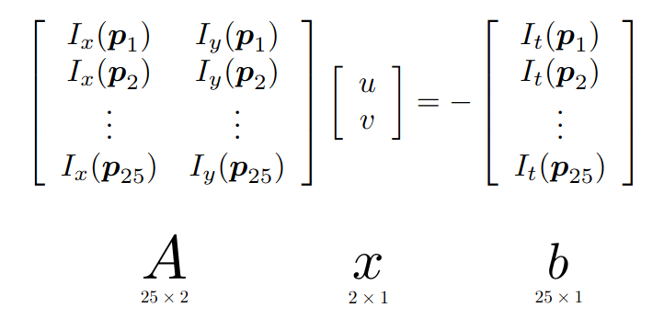
Lucas-Kanade – Optical flow algorithm
3. Neighboring pixel have small displacement
This enables to solve a single equation with two unknowns, by considering a image patch.
Source: http://www.cs.cmu.edu/~16385/s15/lectures/Lecture21.pdf

Slide 15
Lucas-Kanade – Pose Estimation
When no tags are detected, Lucas Kanade optical flow algorithm is applied to estimate the pose.
In a camera image , few equally spaced point are chosen to track the flow.

Slide 16
Challenges
1. The April Tag ROS package message type provides multiple tag detection values in a complex data structure, simultaneous data extraction is necessary to get precise results.
2. In the algoithm to find the nearest tag, the function was stuck to the local minimum.
3.Obtain the correct transformation values from /raspicam_image frame to /base_link frame.

Slide 17
Future scope of work:
1. Integrating Lucas Kanade to update the pose estimation results which is calculated only by using tags.
2. Use the features extracted to determine the points to be tracked in Lucas Kanade.
3. Evaluate the method to other existing techniques for odometry.
4. Use Stereo camera to achieve better results.

Slide 18
References
http://wiki.ros.org/Documentation
http://graphics.stanford.edu/courses/cs348a-17-winter/Papers/quaternion.pdf
https://automaticaddison.com/how-to-convert-a-quaternion-to-a-rotation-matrix/
http://www.cs.cmu.edu/~16385/s15/lectures/Lecture21.pdf
http://www.inf.fu-berlin.de/inst/ag-ki/rojas_home/documents/tutorials/Lucas-Kanade2.pdf

Slide 19
Thank you

